Slide 1
Bi-weekly report autoencoder
Maohua Zhu

Slide 2
outline
A quick review to autoencoder
L-BFGS training algorithm details
Current progress
Next steps

Slide 3
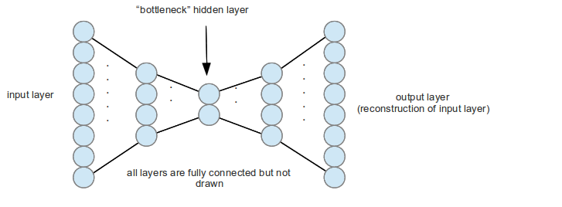
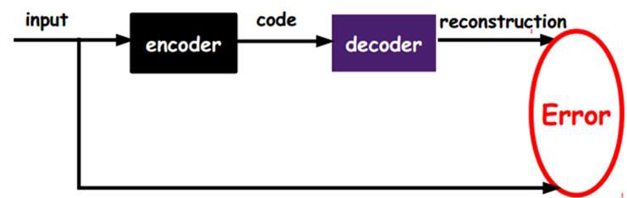
autoencoder
A artificial neural network for learning efficient coding
Forward prop. for encoding
Back prop. for decoding - reconstruction
Widely used in document retrieval and image recognition
Code can be used for semantic hashing
Codes with short Euclidean distance are similar semantically

Slide 4
L-BFGS Training algorithm
Training Process
Randomly initialize weights
Forward prop. using mini-batch
Compute the cost and its gradient in weight space(back prop.)
L-BFGS update
Calculate a positive definite matrix H
Multiply the gradient by H to get step direction
Line search on the direction to get the step size
Update weights

Slide 5
Experiment on CPU
Matlab implementation
Dataset:
CIFAR10, image size 32*32
10000 images
Network size:
3072 input
[6144 100] hidden layer
L-BFGS is time consuming
Calculate positive definite matrix
Line search
Euclidean distance (MSE)

Slide 6
Current progress
Analysis of L-BFGS algorithm √
Read Matlab code √
Port Matlab to C++
Load data √
Random initialization √
Forward propagation √
Calculate gradients – back propagation
L-BFGS …
Port C++ to OpenCL/CUDA

Slide 7
Next steps
Coding++

